Slide 1
Comparison of datasets and models in a clinical trial busn 6660: predictive modeling with big data
Douglas Stinson
Prateek Bhadsavle
AviNash Kamath

Slide 2
Copdgene clinical research study
COPD = emphysema (lung tissue loss) + chronic bronchitis (airways inflammation)
Genetic Epidemiology of COPD (www.copdgene.org)
Observational investigation of current and former cigarette smokers, age 45-80, with a smoking history ≥ 10 pack years
1 pack/day * 10 years, 2 packs/day * 5 years, etc.
Sponsored by the National Institutes of Health (NIH) National Heart Lung and Blood Institute (NHLBI)
10,300 research subjects enrolled (8,047 with complete data)
Data types collected
GWAS (genetic information)
CT Scan (VIDA Diagnostics and 3D Slicer measurements)
Pulmonary Function Testing (ndd EasyOne Spirometer)
Surveys and Questionnaires
Demographics and Body Measurements
Exercise Tolerance Testing (6 Minute Walk)
Structured data cleaning and EDA processes

Slide 3
project questions
Is there a difference in predictive value between traditional data and imaging data?
Is principal components regression better than linear regression for either dataset?

Slide 4
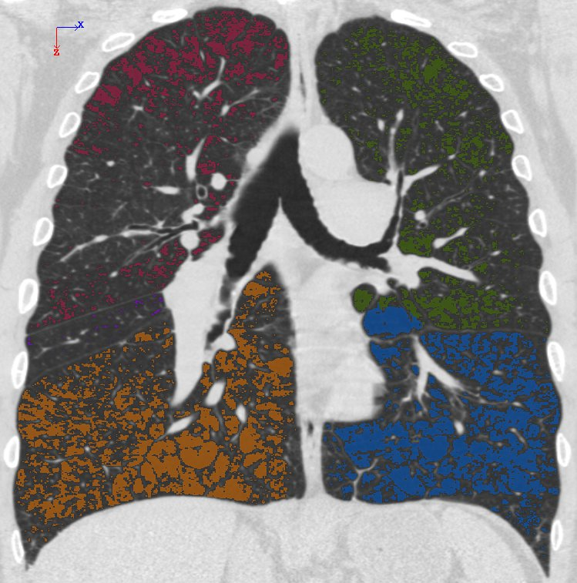
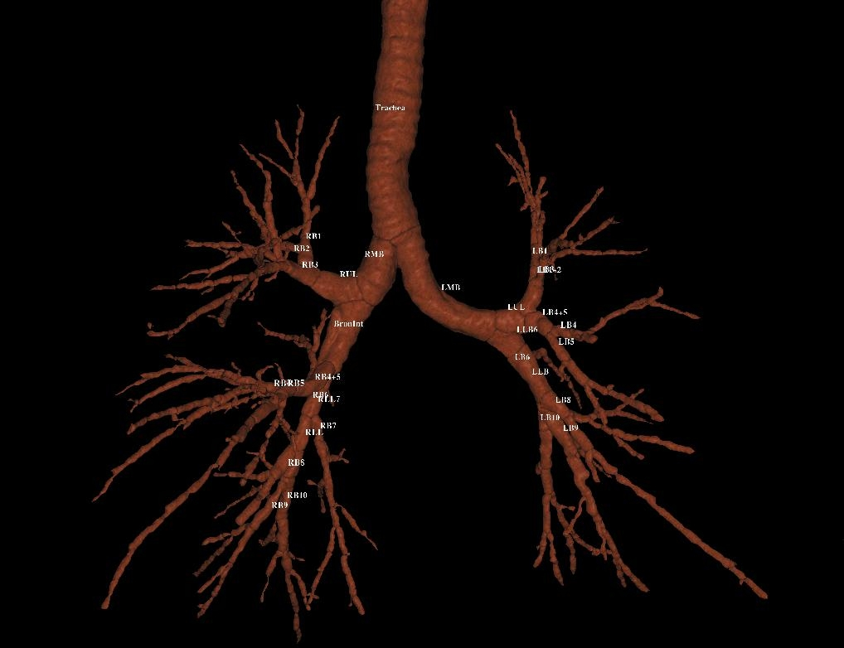
Data types
Traditional (in use for decades)
Imaging (last 10 years)
SaO2: measurement of blood oxygen
O2: liters per minute of supplemental oxygen
Distance: 6MW distance walked (ft.)
Smoking Start Age
Years Since Smoking Stopped
Current Cigarettes per Day Smoked
Pack Years: calculated
Smoking Duration: # years
Insp910: emphysema
Insp 15th percentile: emphysema
Insp Intensity Mean: emphysema
Exp856: airways
Exp 15th percentile: airways
Exp Intensity Mean: airways
Exp/Insp Ratio: airways and emphysema
Upper 1/3: emphysema
Lower 1/3: emphysema
Upper 1/3 / Lower 1/3 Ratio: emphysema
Pi10: airways
Pi15: airways
Wall Area % - segmental: airways
TLCpp: measured lung volume vs. predicted (“full”)
FRCpp: measured lung volume vs. predicted (“empty”)

Slide 5
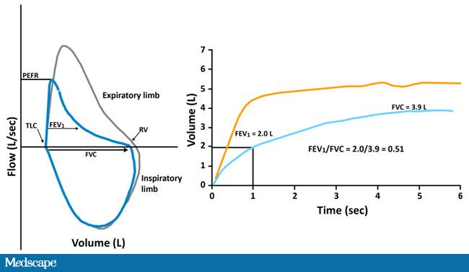
End points
Lung Function
Used to diagnose COPD and to classify severity
FEV1 % predicted: actual vs. predicted lung volume exhaled in 1st second of forced exhalation
FVC % predicted: actual vs. predicted lung volume exhaled in entire forced exhalation
FEV1/FVC: ratio of actual FEV1 to actual FVC

Slide 6
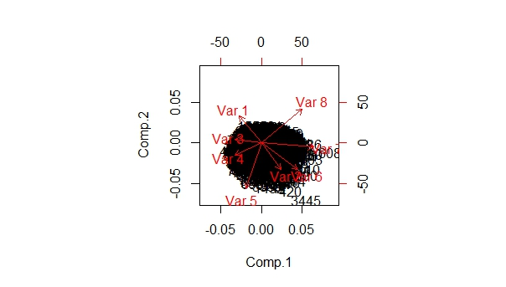
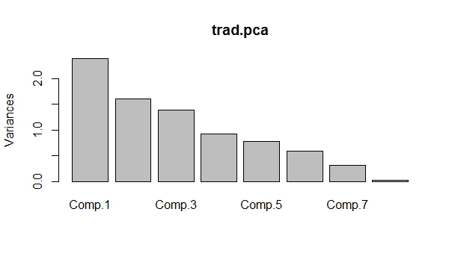
Principal components analysis: traditional

Slide 7
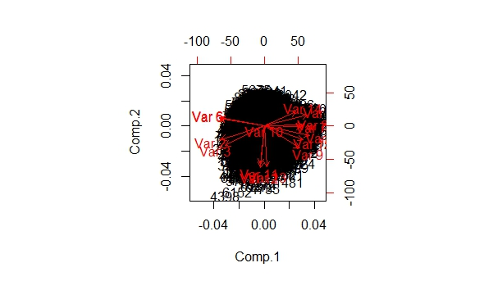
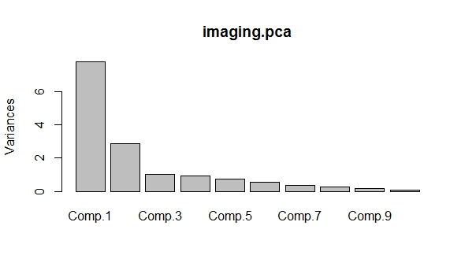
Principal components analysis: imaging

Slide 8
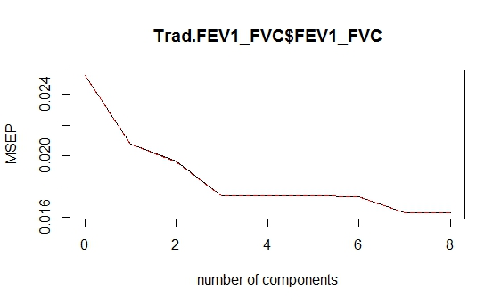
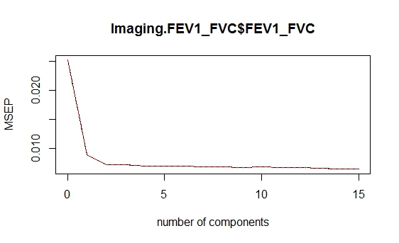
Model comparisons

